Slide 1
JIRA —
A tool for tracking software defects
Kris Wang
JUL.18, 2014

Slide 2
Agenda
How to create a bug in JIRA
How to assign a task in JIRA
How to manage filters in JIRA
JIRA queries

Slide 3
SESSION 1: How to create a bug in JIRA

Slide 4
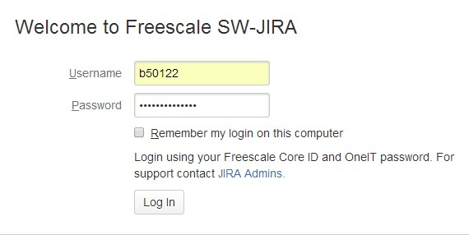
How to create a bug in JIRA
Step 1 http://sw-jira.freescale.net/ - log-in with FSL User Account and Password. If it is the first time you log in, you should register first.

Slide 5
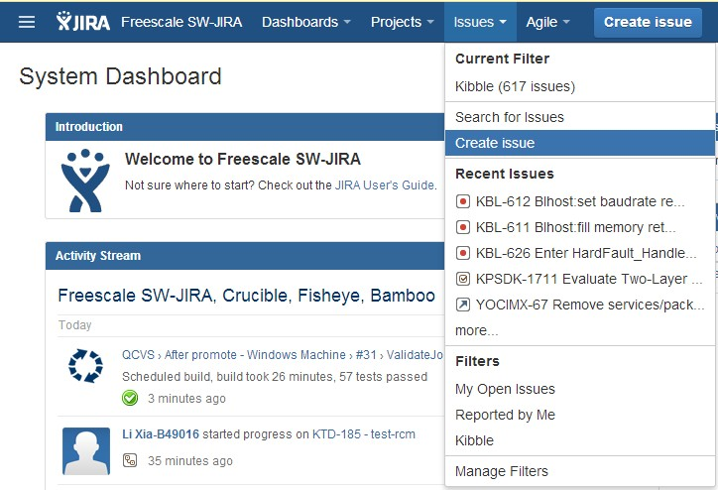
How to create a bug in JIRA
Step2 Click the option menu “Create issue”, or click option menu “Issues” and select “Create issue”, or hit the keyboard shortcut “C”.

Slide 6
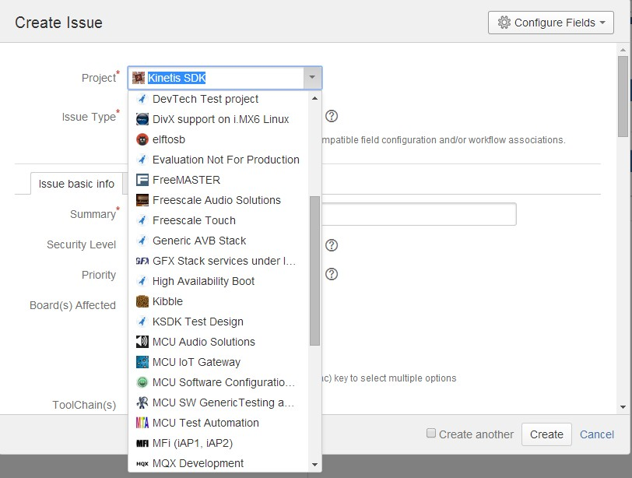
How to create a bug in JIRA
Step3 select the project you are taking part in. (e.g. Kinetis SDK, KSDK Test Design, …)

Slide 7
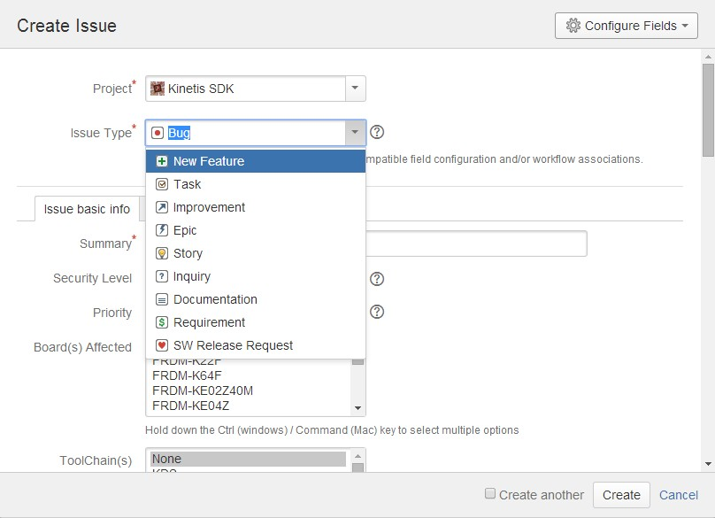
How to create a bug in JIRA
Step4 Issue Type: Bug

Slide 8
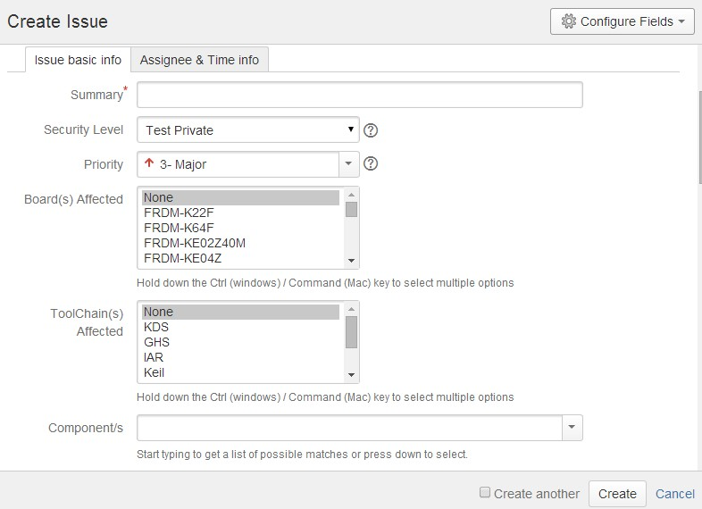
How to create a bug in JIRA
Step5 Make a summary for the bug as a bug title.
Summary
[Area][Module]: <Bug Summary>possibility
1) Area: app
2) Module: hello_world, spi_flash, gpio_i2c etc.
3) Bug Summary: The information should be simple and describe the bug as clearly as possible.
4) Possibility: The frequency of the issue occur
5) Example:
[Demo][spi_flash]: This demo always runs to fail on TWR-K22 rev B board.

Slide 9
How to create a bug in JIRA
Step6 You’d better choose Test Private as the “Security Level”, to let others review it and make sure whether it is a bug.

Slide 10
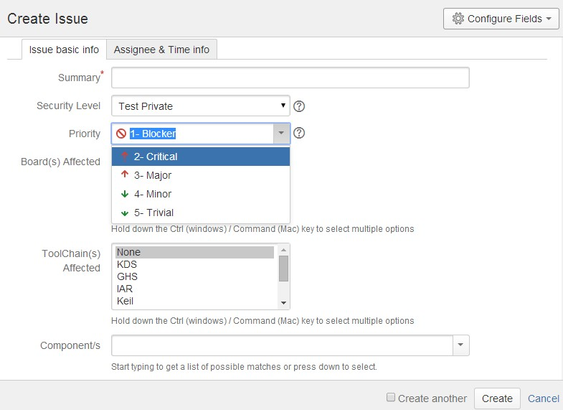
How to create a bug in JIRA
Step7 Set the priority according to the bug.
Priority Options:
1 –Blocker (the main functionality is not working, the software is un-usable, no possible workaround, possible showstopper, HF to be prepared)
2 – Critical (essential functionality is impaired)
3 – Major (functional bug, but the essential functionalities are not impacted)
4 – Minor (non-functional, unapparent problem)
5 –Trivial (comments errors..)

Slide 11
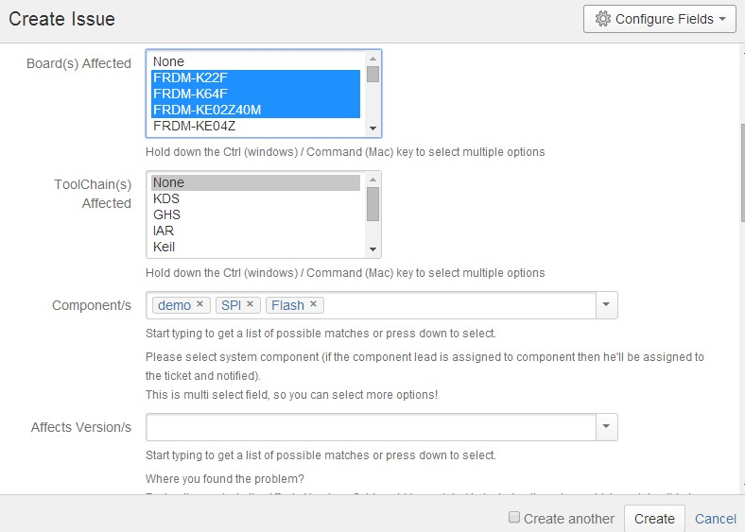
How to create a bug in JIRA
Step8 Select affected board(s) for the bug.

Slide 12
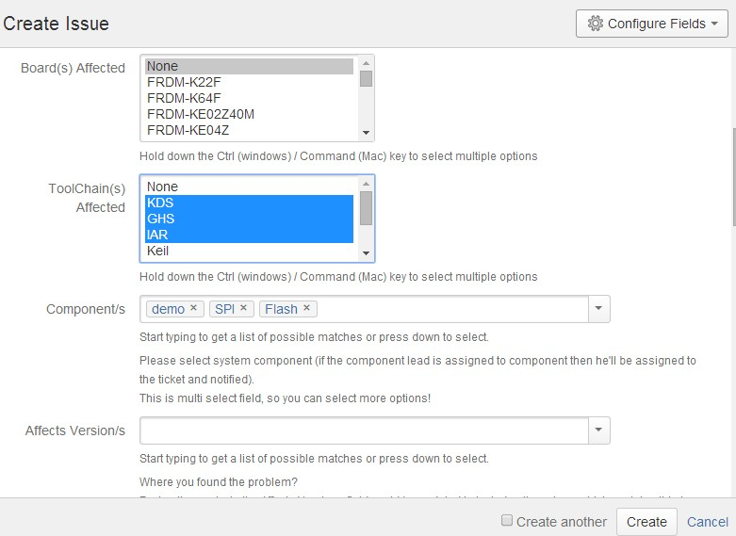
How to create a bug in JIRA
Step9 Select affected tool chain(s) for the bug.

Slide 13
How to create a bug in JIRA
Step10 Select system component(s) for the bug.

Slide 14
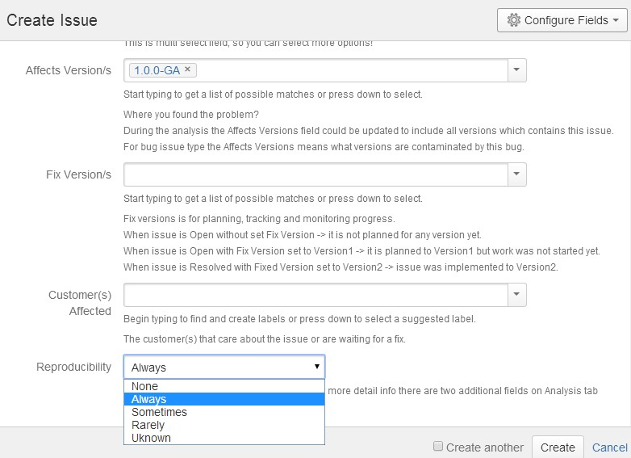
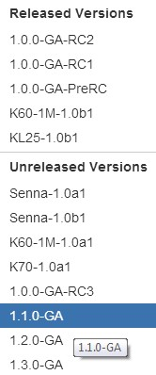
How to create a bug in JIRA
Step11 Select what version(s) is (are) contaminated by the bug.

Slide 15
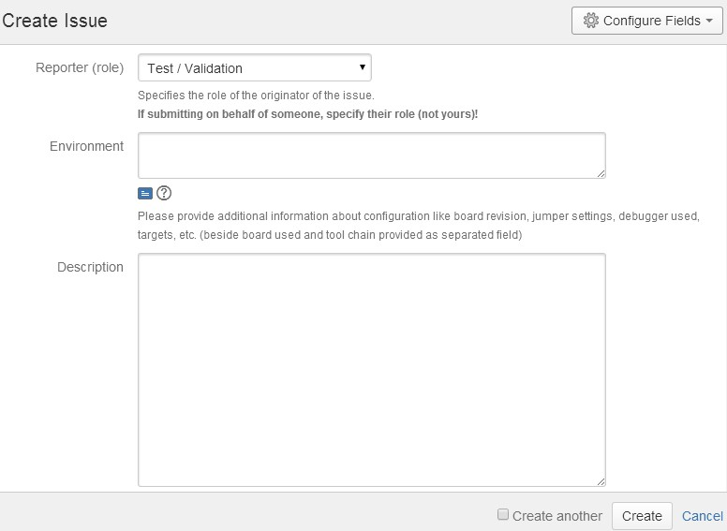
How to create a bug in JIRA
Step12 Select system component(s) for the bug.
Environment
1) Git commit number(Only use when test daily image).
2) Target board and serial number: TWR-K22F120M serial number 629962-00066-4213-27957.
3) Tool(s): IAR6.7, etc.

Slide 16
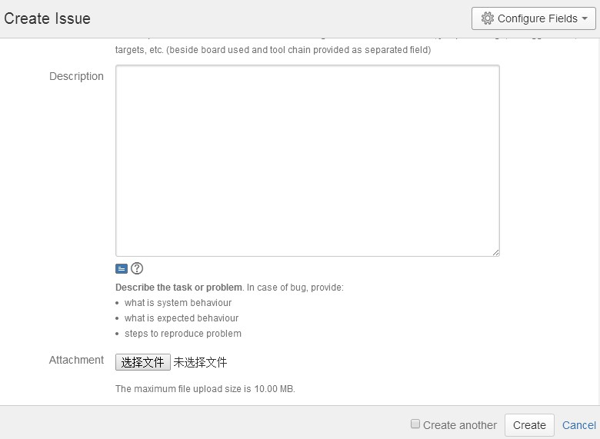
How to create a bug in JIRA
Step13 Describe the bug.
Describe the bug clearly. Add following contents with tag (JIRA text effects, *Bold* -- Bold, {code} code {code} – display codes):
Description:
Reproduce steps:
Expected result:
Others:
1) If it could not compile, paste the error number in description.
2) Steps to reproduce the issue.
3) Describe the expected result and the factual result you got, for example the log or the LED blinking or sound.
4) If you find the solution, you can add in others tag.
Attach pictures or attachments if necessary.

Slide 17
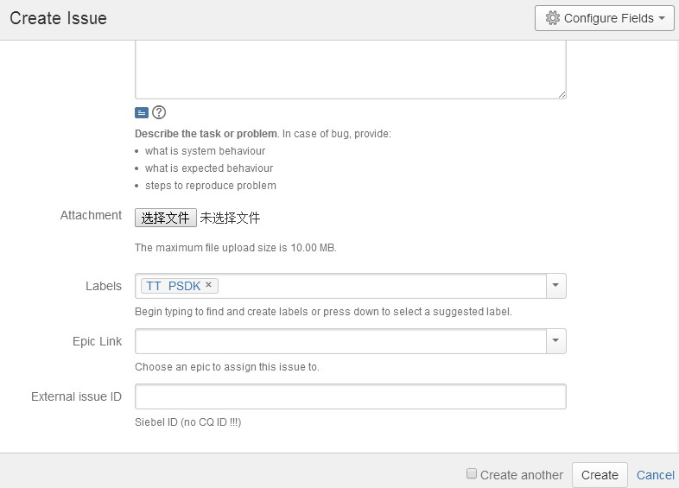
How to create a bug in JIRA
Step14 Add labels for the bug.
If the label exists, choose it. Otherwise create a new one. For example, TT_PSDK, demo, startup, TWR-K64-F120M, etc.

Slide 18
SESSION 2: How to assign a task in JIRA

Slide 19
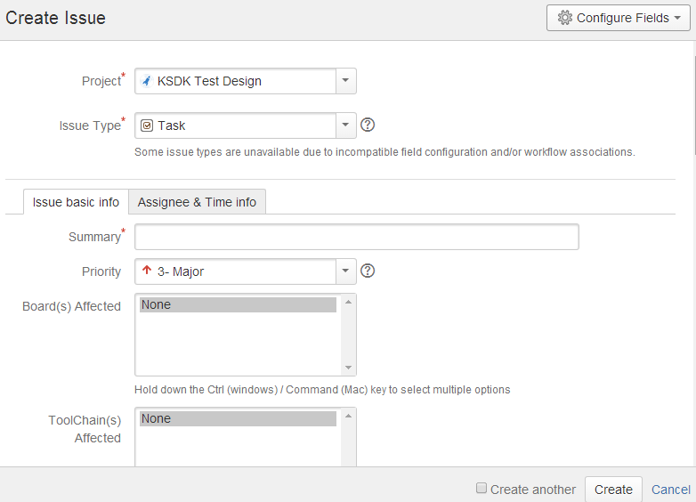
How to assign a task in JIRA
Step 1 http://sw-jira.freescale.net/ - log-in with FSL User Account and Password. Click the option menu “Create issue”, or click option menu “Issues” and select “Create issue”, or hit the keyboard shortcut “C”, you will see
Project: KSDK Test Design
Issue Type: Task

Slide 20
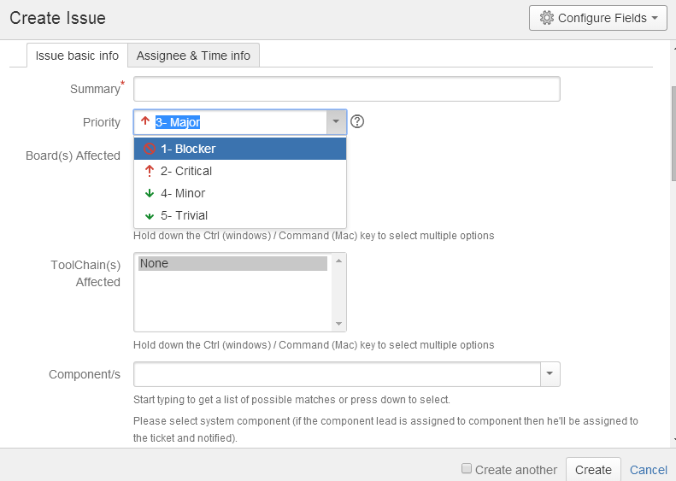
How to assign a task in JIRA
Step2 Issue basic Information settings.
Describe the task as clearly as possible
Select the priority for the task
You can select one or more components that match the task.

Slide 21
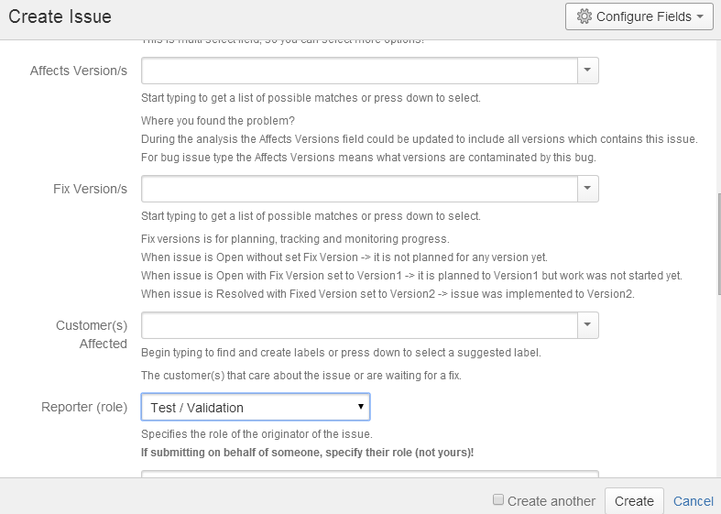
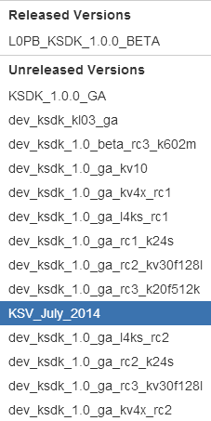
How to assign a task in JIRA
Issue basic Information settings.

Slide 22
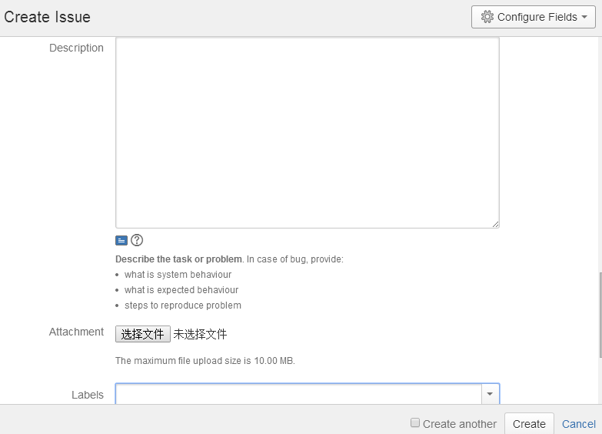
How to assign a task in JIRA
Issue basic Information settings.
Describe the task in detail here.
If the label exists, choose it. Otherwise create a new one. For example, TT_PSDK, demo, startup, TWR-K64-F120M, etc.

Slide 23
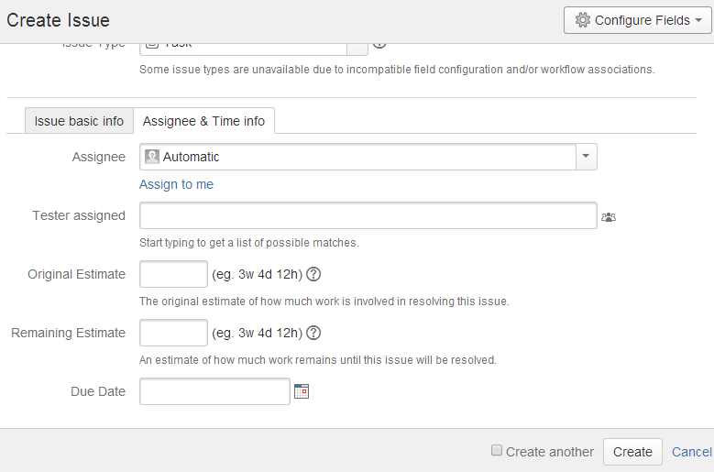
How to assign a task in JIRA
Step3 Assignee & Time Information settings.
Assign the task to somebody.
How much work is involved to finish the task.
The remaining work to get the task done.
Click “Create” to finish the task assignation.
Set due date for the task.
Cycle it if you want to create another task.

Slide 24
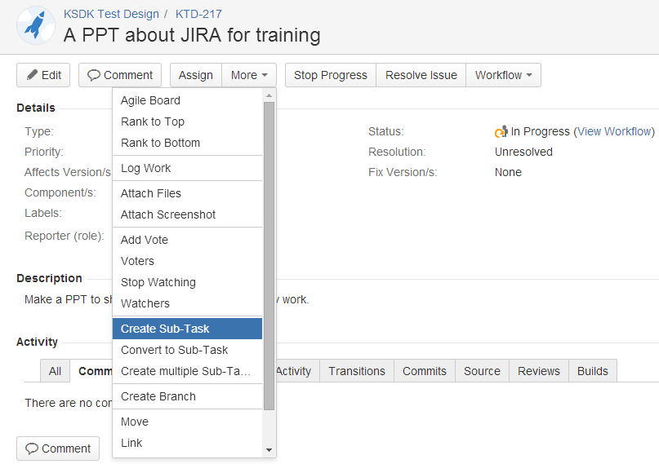
How to assign a task in JIRA
Step4 You can add watchers and create some subtasks for the task.
Edit: You can edit your task after creating it.
Comment: Add comments for the task. (How to resolve the task, what problems encountered, etc.)
Start/Stop Progress: Start or stop the task.
Resolve Issue: Click it after getting the task done.

Slide 25
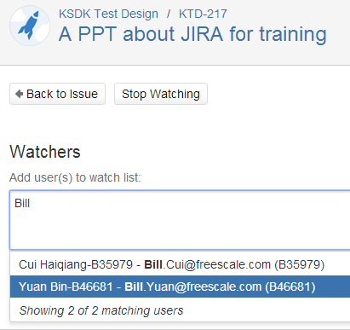
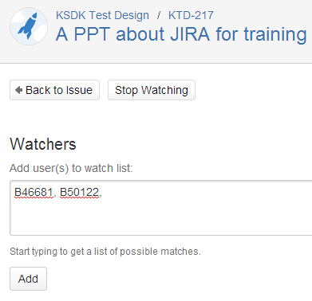
How to assign a task in JIRA
Step5 Add watchers

Slide 26
SESSION 3: How to manage filters in JIRA

Slide 27
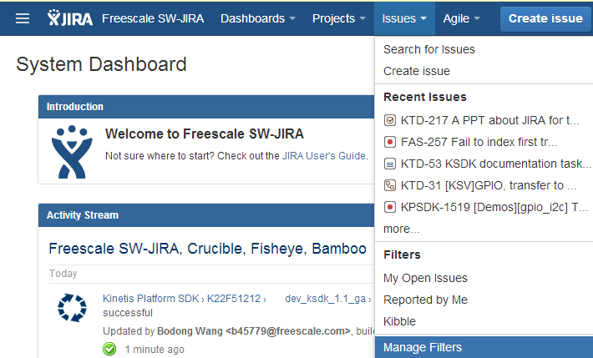
How to manage filters in JIRA
Step 1 http://sw-jira.freescale.net/ - log-in with FSL User Account and Password. There is an option “Manage Filters” in the menu “Issue”.
Click here you’ll see your reported bugs and your assigned tasks.
Quick search here.

Slide 28
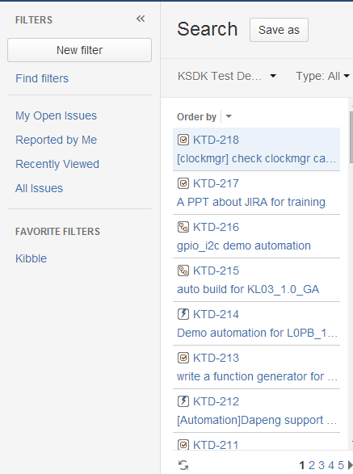
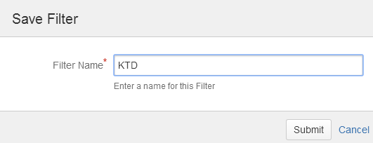
How to manage filters in JIRA
Step2 Save the filter.

Slide 29
SESSION 4: JIRA queries

Slide 30
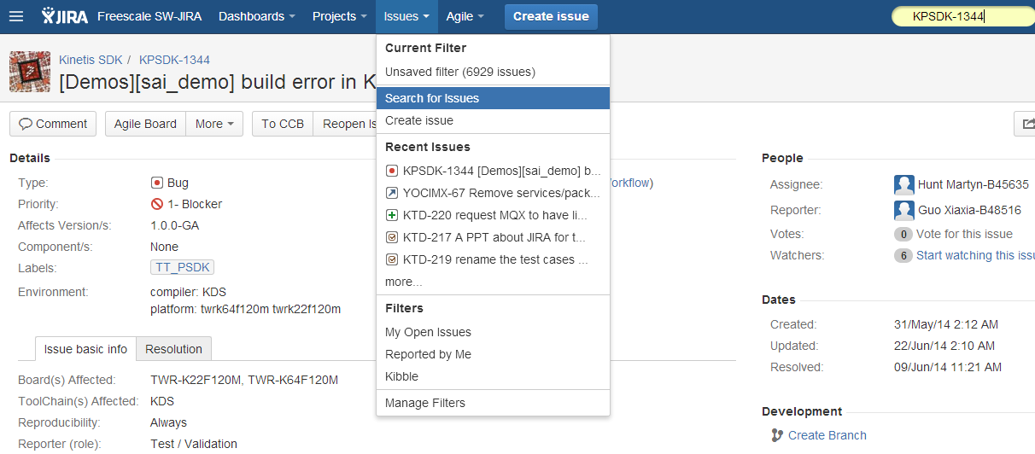
JIRA queries
http://sw-jira.freescale.net/ - log-in with FSL User Account and Password Select affected board(s) for the bug.
You can search the task and bug here according to the task ID or bug ID. e.g. KTD-220, KPSDK-1344, etc.

Slide 31
Query tasks
This week plan
project = "KSDK Test Design" AND (status = open OR status = Analysis OR status = "In Progress") AND duedate <= endOfWeek() And assignee = currentUser() ORDER BY priority DESC, due DESC
This week achievement
project = "KSDK Test Design" AND (status = Resolved OR status = Closed) AND (duedate >= startOfWeek() AND due <= endOfWeek()) And assignee = currentUser() ORDER BY priority DESC, due DESC
Next week plan
project = "KSDK Test Design" AND (status = open OR status = Analysis OR status = "In Progress") AND duedate <= "2014/07/25" And assignee = currentUser() ORDER BY priority DESC, due DESC

Slide 32
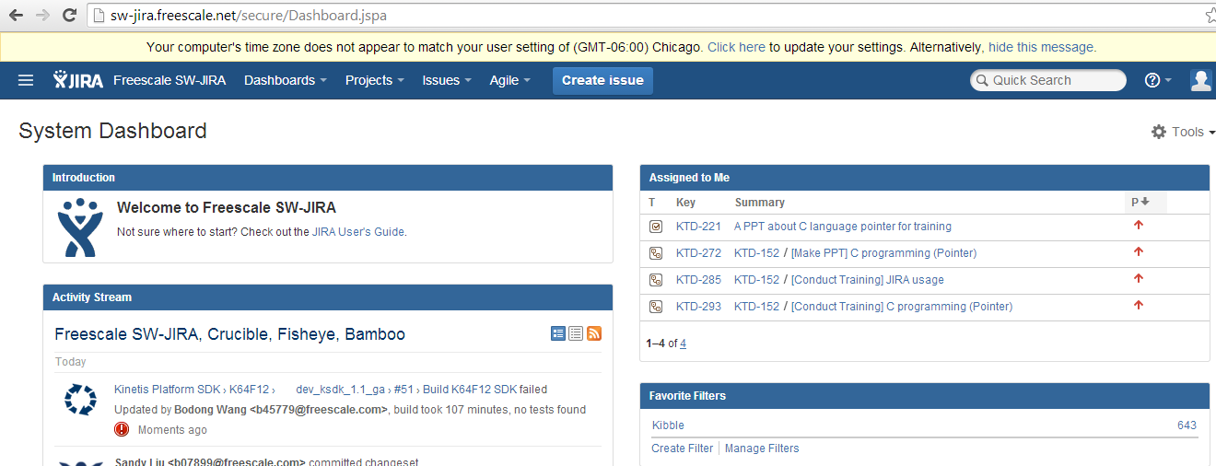
Operation steps
Step 1: http://sw-jira.freescale.net/ - log-in with FSL User
Account and Password.
Step 2: click “Create Filter”

Slide 33
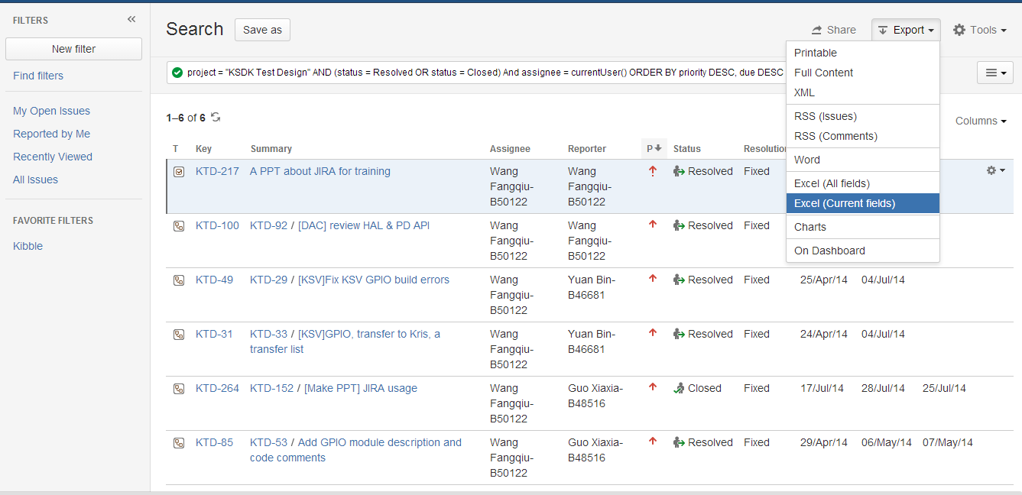
Operation steps
Step 4: choose one format to export the query.
Step 3: input the query statement here and search.

Slide 34
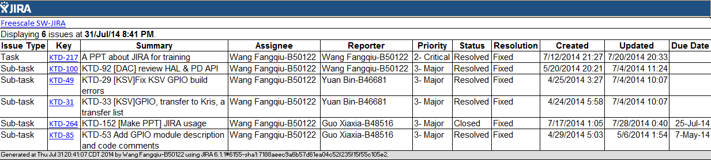
Operation steps
Step 5: copy the export information to your weekly report.

